Slide 1

Help and Click

Slide 2

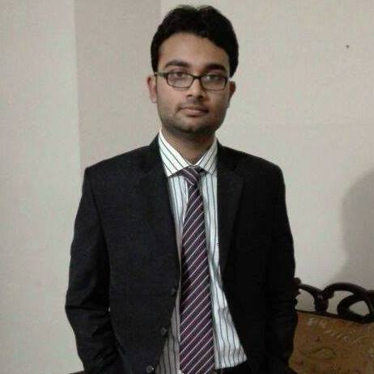


Shadman Majid
DATABASE AND BACKEND DEVELOPER
Department of Computer Science Engineering (CSE)
Bangladesh University of Engineering and Technology (BUET)
Md. Rownak Islam
UX AND UI DESIGNER
Department of Water Resources Engineering (WRE)
Military Institute of Science and Technology (MIST)
Help and Click
Farhan Sadik Sium
IDEA AND MARKETING
Department of Electrical and Electronics Engineering (EEE)
Bangladesh University of Engineering and Technology (BUET)
Concept ID : 034
Team : Shonar Bangla
EATL PROTHOM ALO APP CONTEST 2016

Slide 3
Did You Know??
Missing
261
Road Accident
712
Unclaimed bodies
967

Slide 4
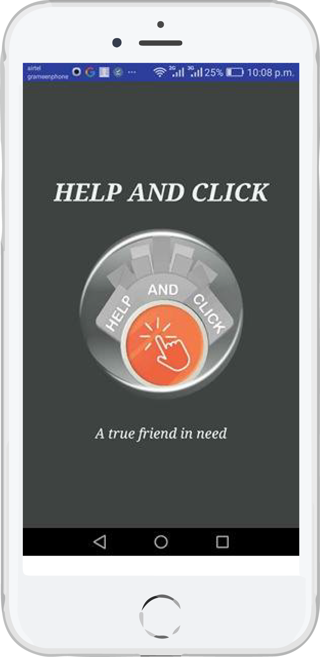

Social Network
Post “Notice” if someone is missing
Post “Incident” if you find someone

Slide 5
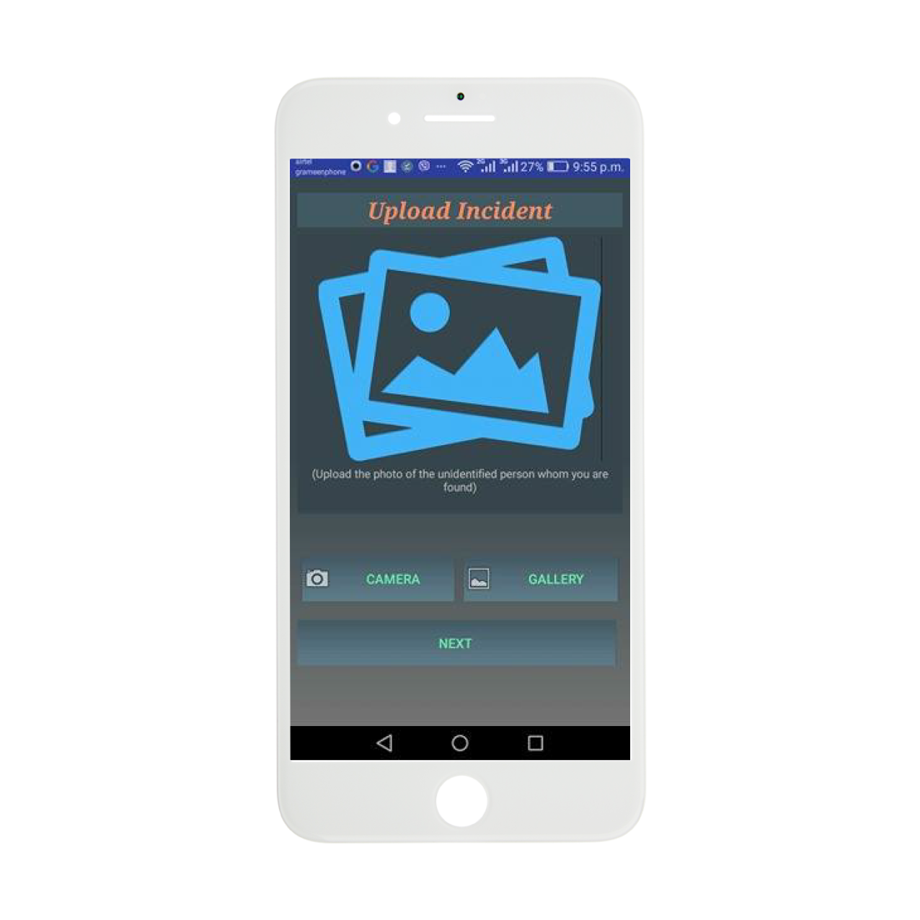
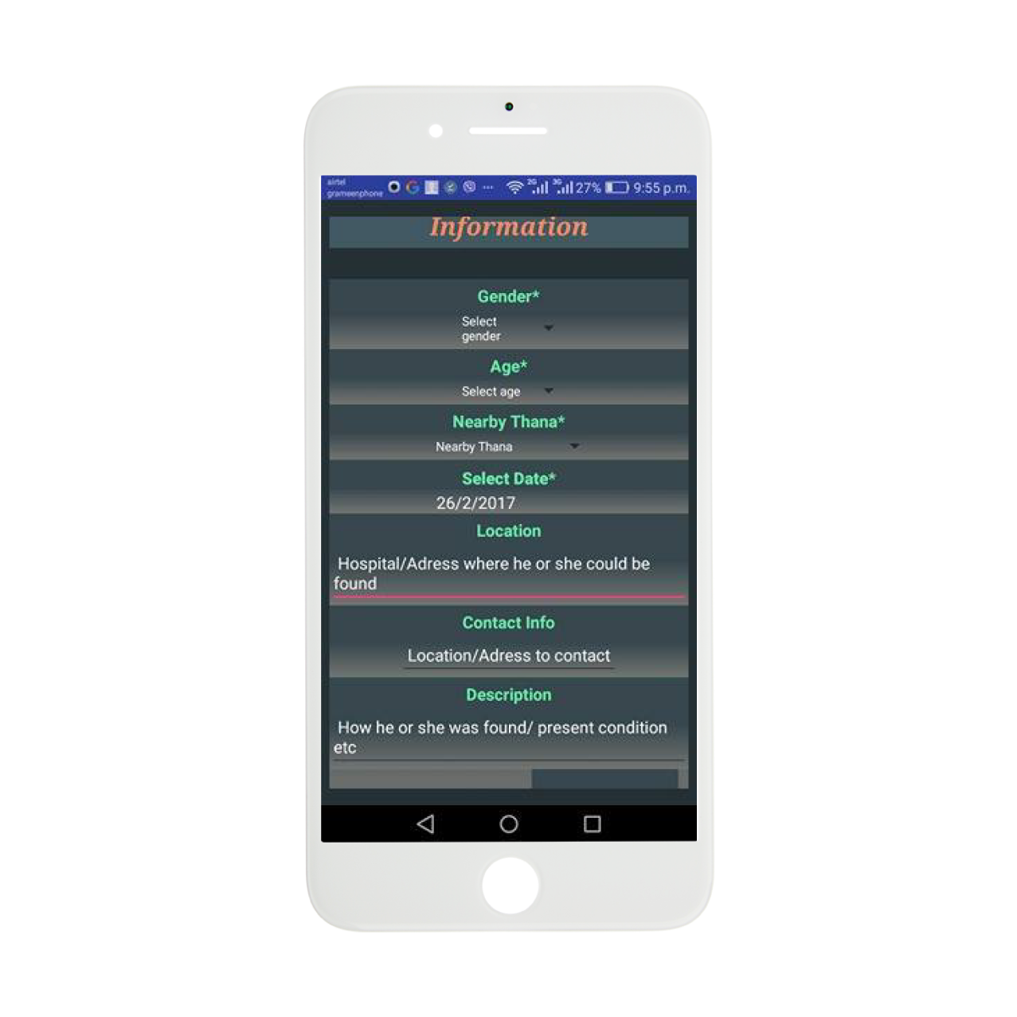
Uploading Post
Upload “Image” using camera or gallery
Fill up necessary relevant “Information”

Slide 6
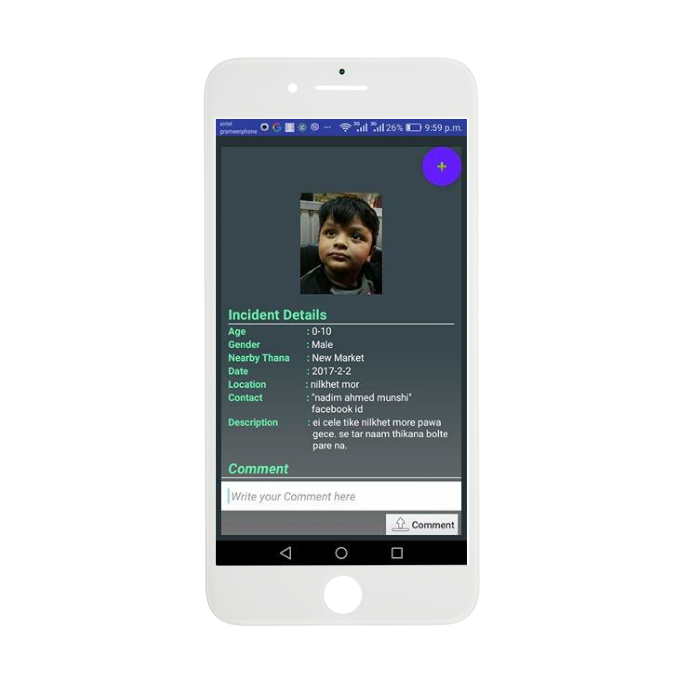
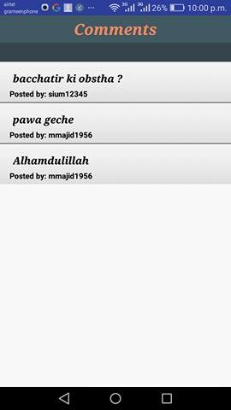
Connect With Comments
to keep contact with every app user
useful to find out resourceful information

Slide 7
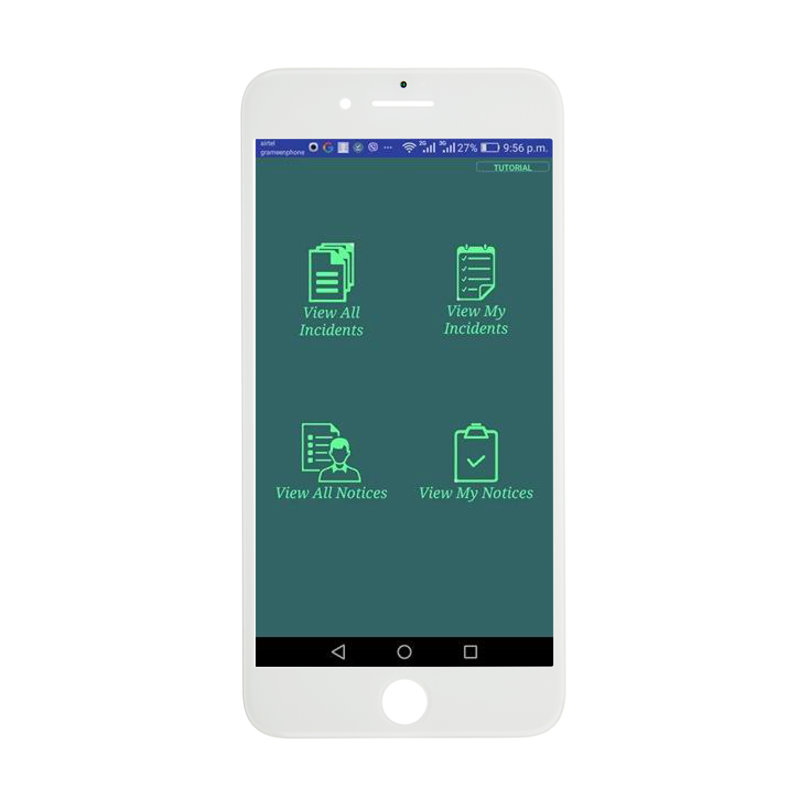
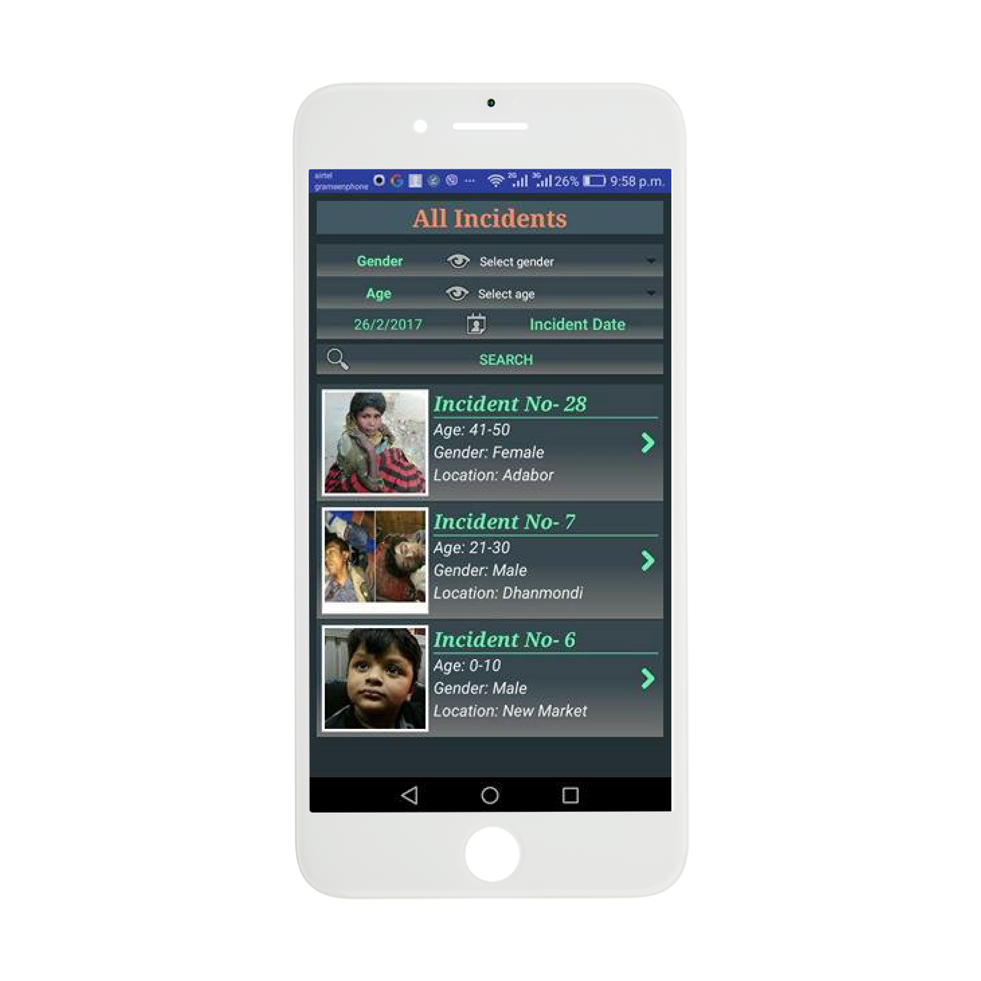
Search Filtering
Age
Gender
Location
Missing Date

Slide 8
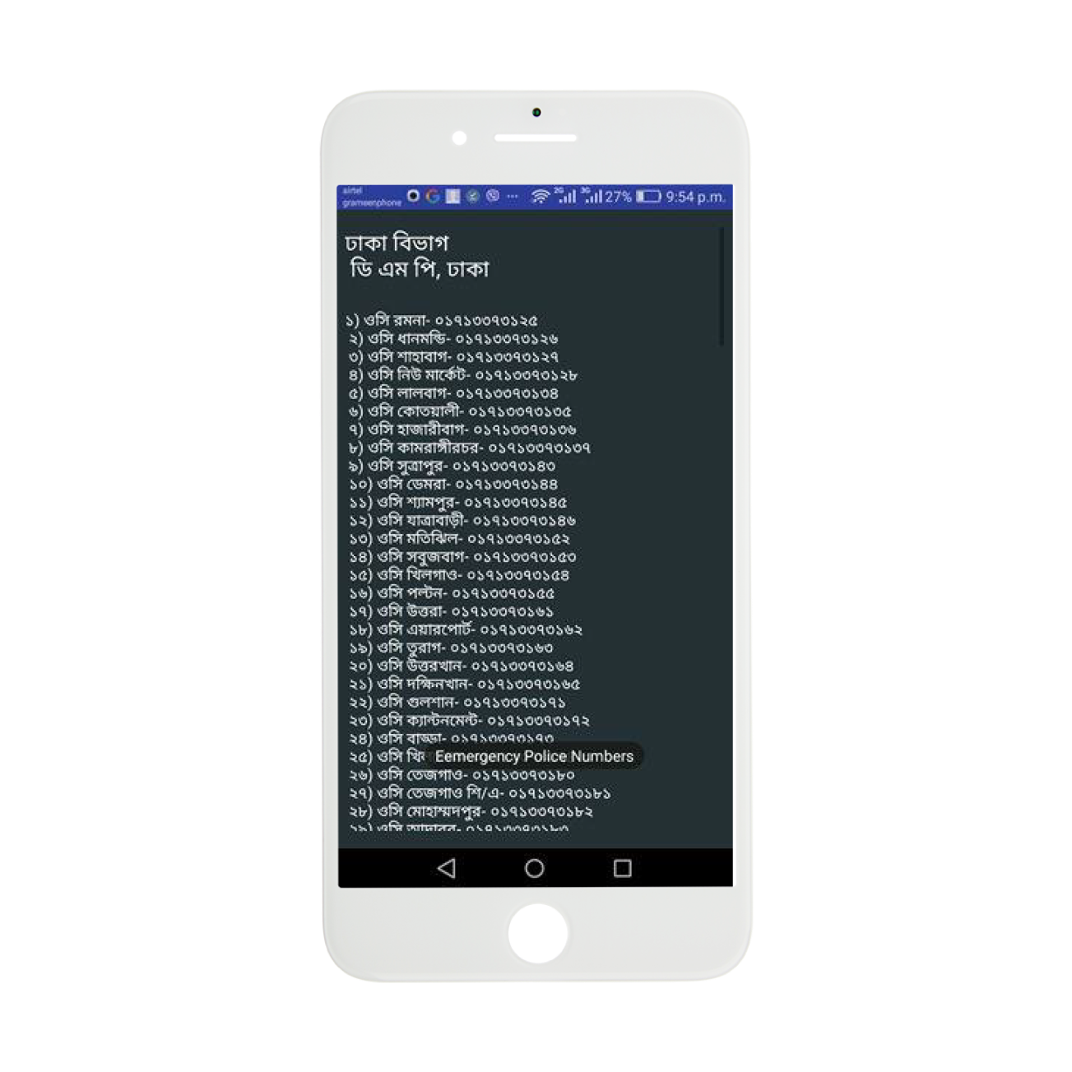
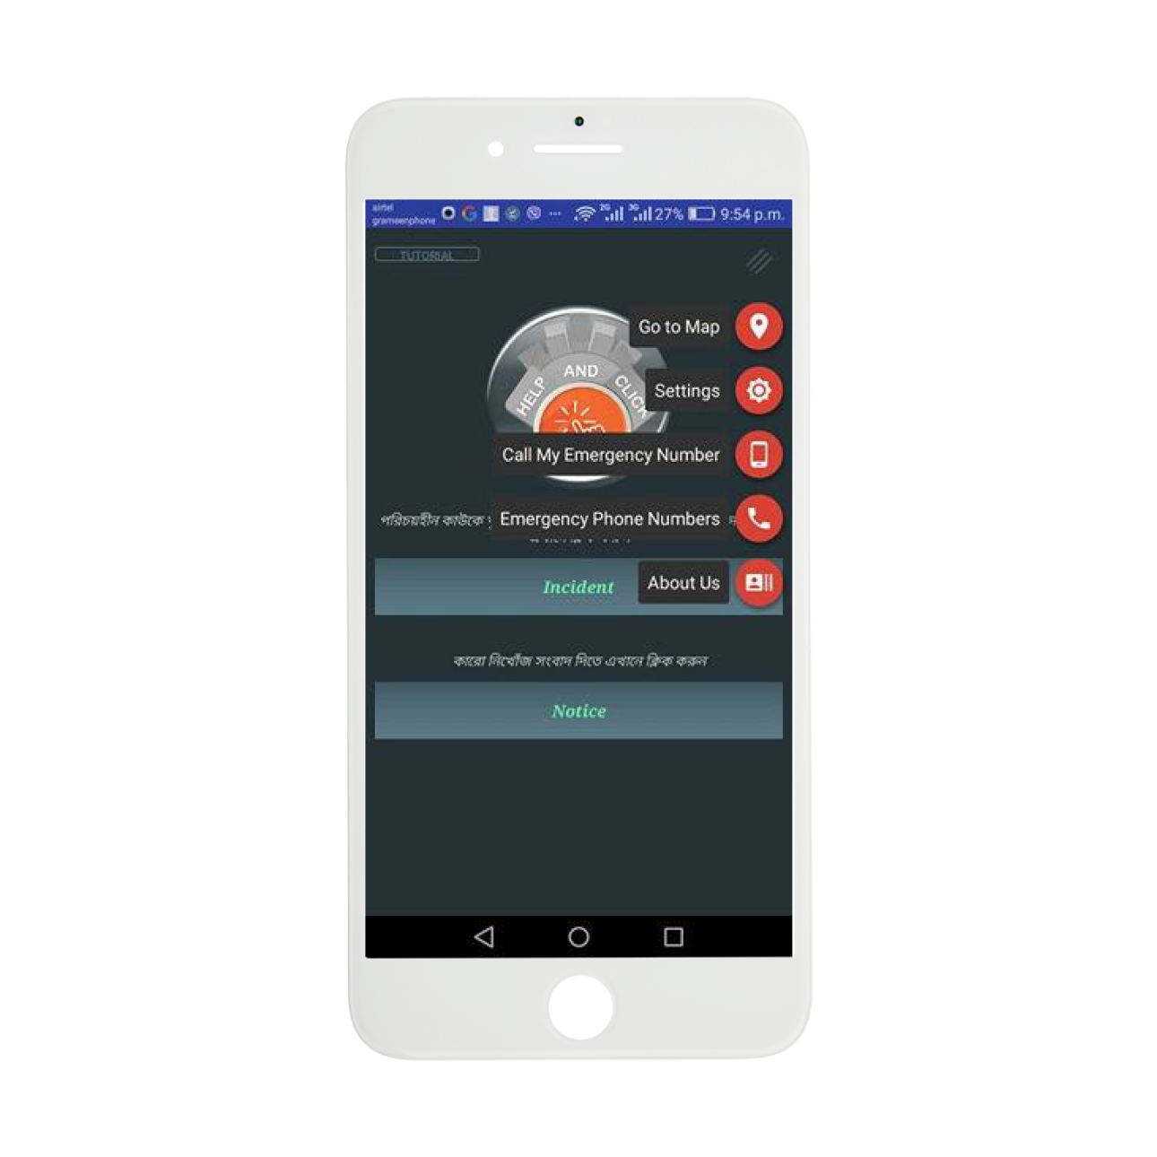
Emergency
Call My Emergency Number
Go to Map
Emergency Phone Numbers

Slide 9




Why
Help and Click?
Ease of Spreading
Dedicated Platform
Free of Cost

Slide 10




Why
Help and Click?
Crowd Sourcing
Lifespan
Anonymity

Slide 11

Vision
Nationwide Network
Authorized Access
Different OS Platform

Slide 12

Business Plan
Donation
CSR and Sponsorships
Government

Slide 13
Promotional Activities

Slide 14
References
http://archive.dhakatribune.com/bangladesh/2016/jul/20/rab-publishes-list-261-missing-people
http://203.112.218.65/WebTestApplication/userfiles/Image/SubjectMatterDataIndex/YB-2012.pdf
http://www.somewhereinblog.net/blog/appel_mahmood/29298846

Slide 15
Thank You

